Slide 1
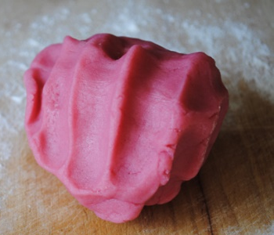
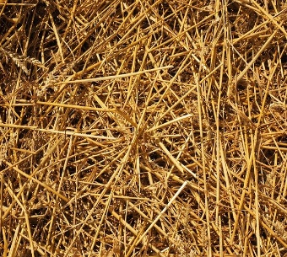
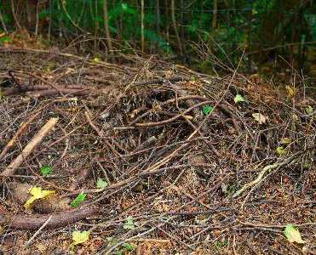
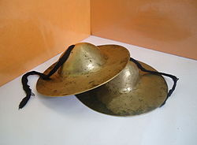
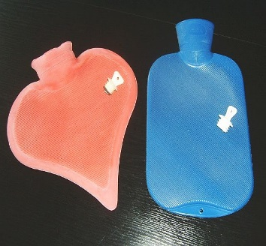
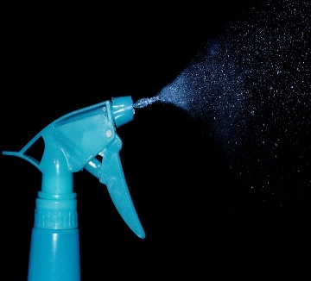
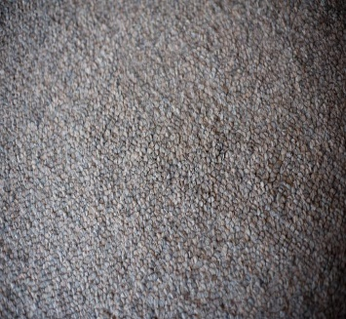
For this story, you will need:
Pink playdough for the pigs
straw
sticks
Sand paper for the bricks
Fan for blowing down the houses
Cymbals for the houses crashing down
Look out for the pictures so you know when to use each item.
Warm heat bag or water bottle as the pot of water
Water spray for the splash into pot.
Grey fur or soft material for the wolf

Slide 2
The 3 Little Pigs

Slide 3
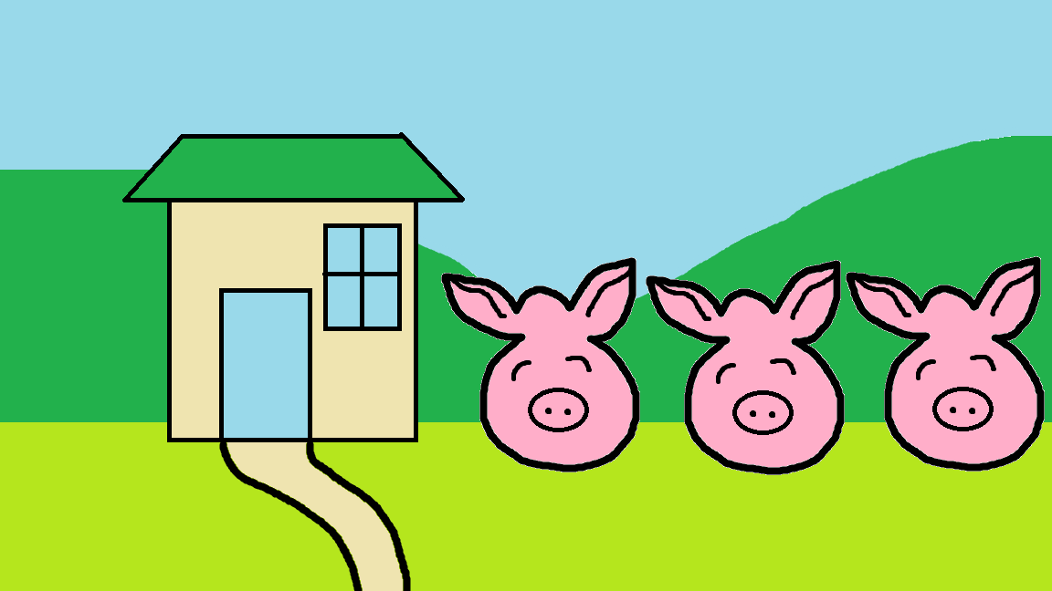
One day, the 3 little pigs left home to build their own houses.

Slide 4
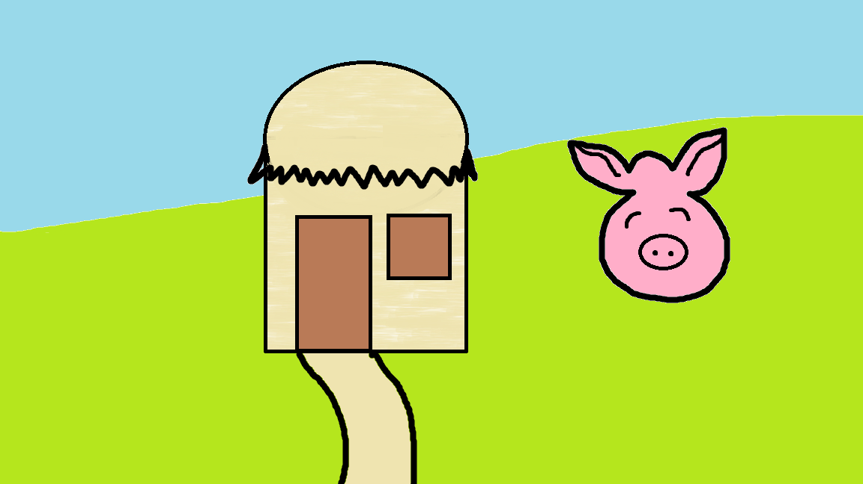
The first pig made a house out of straw.

Slide 5
Then one day, a wolf came by.

Slide 6
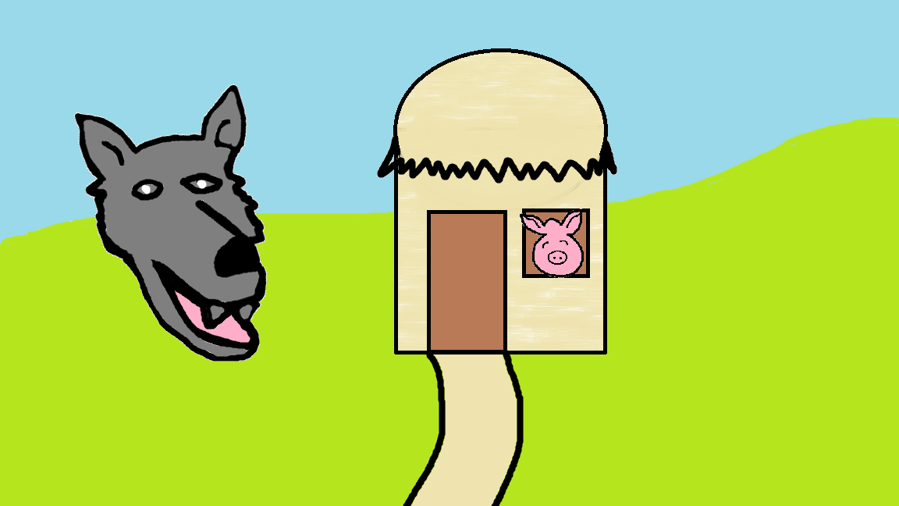
“Little pig, little pig, let me in” said the wolf.
“No, no, no. Not by the hair on my chinny chin chin” said the little pig.
The wolf huffed and puffed and the house fell down.

Slide 7
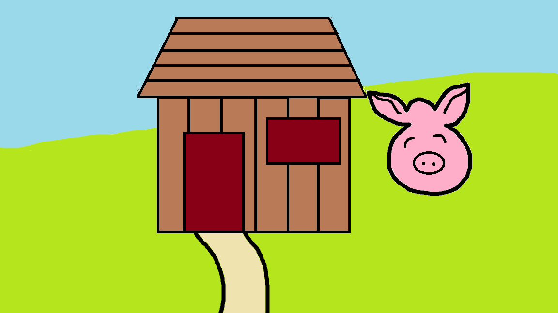
The second pig made a house out of sticks.

Slide 8
Then one day, a wolf came by.

Slide 9
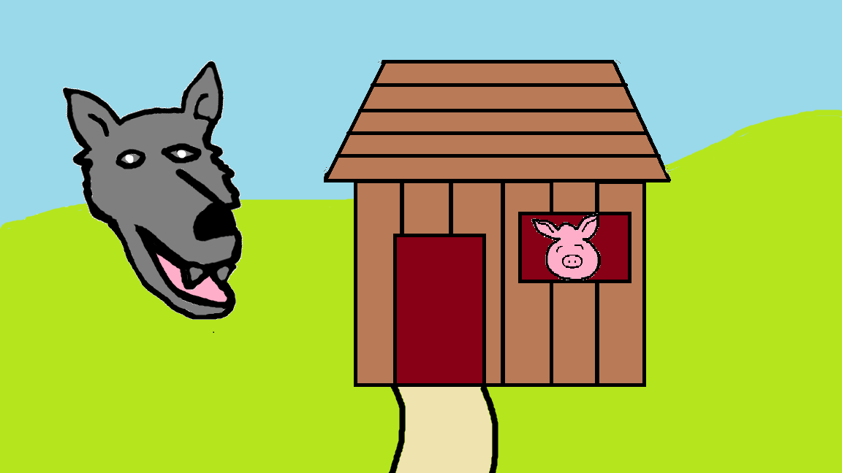
“Little pig, little pig, let me in” said the wolf.
“No, no, no. Not by the hair on my chinny chin chin” said the little pig.
The wolf huffed and puffed and the house fell down.

Slide 10
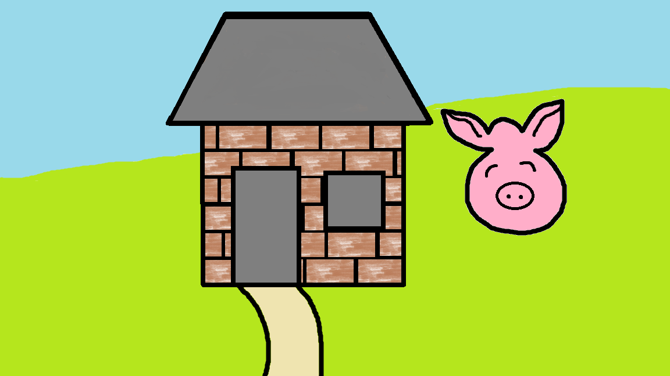
The third pig made a house out of bricks.

Slide 11
Then one day, a wolf came by.

Slide 12
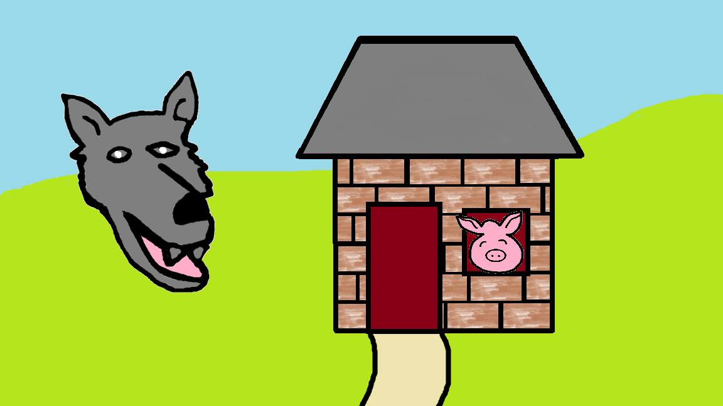
“Little pig, little pig, let me in” said the wolf.
“No, no, no. Not by the hair on my chinny chin chin” said the little pig.
The wolf huffed and puffed and huffed and puffed but the house stood still.

Slide 13
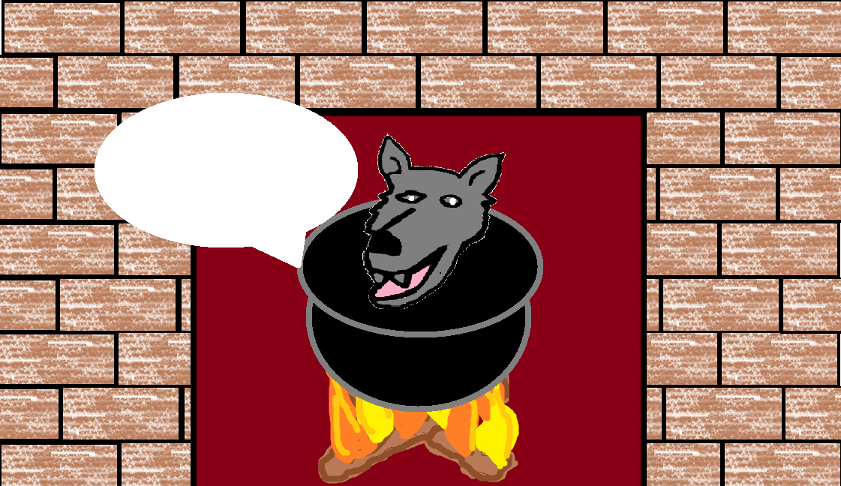
The wolf climbed onto the roof and went down the chimney. The wolf then feel into a pot of hot water.
‘Oww!’ said the wolf.
He jumped out of the pot and ran out of the door.
Ooooowwwww!

Slide 14
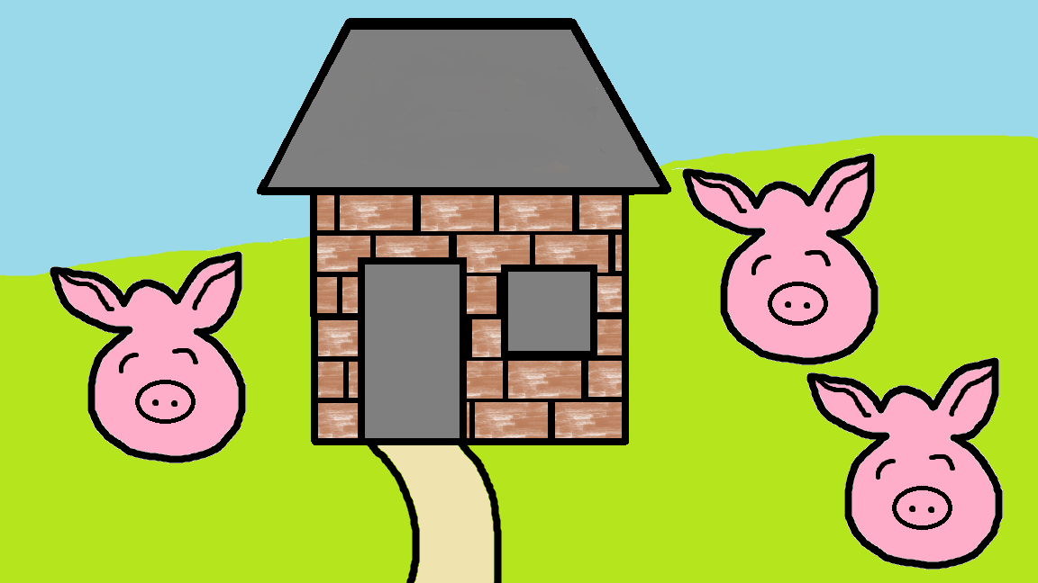
They all lived happily ever after and the wolf was never seen again.

