Slide 1
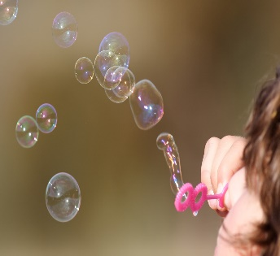
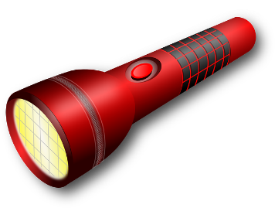
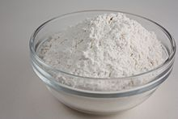
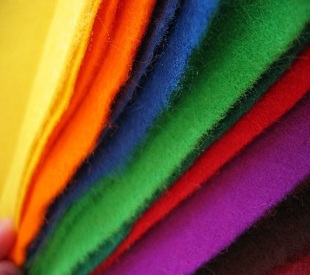
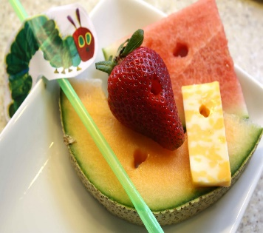
For this story, you will need:
For the moon and the sun
Pop out of the egg
Each time the caterpillar is hungry
To eat and lay on
The egg
Full of flour to be the fat caterpillar
Look out for the pictures so you know when to use each item.
Textured material as the butterfly
You don’t need all of them from the story
To wrap up like the cocoon

Slide 2
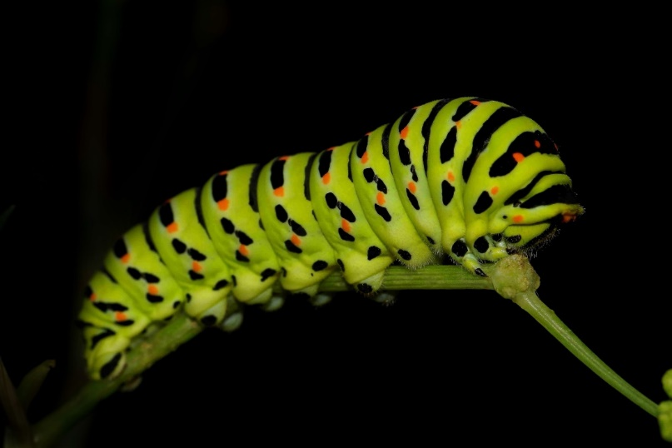
The Very Hungry
Caterpillar

Slide 3
In the light of the moon, a little egg lay on a leaf.

Slide 4
One Sunday morning, the warm sun came up and POP!
Out of the egg came a very tiny and hungry caterpillar.

Slide 5
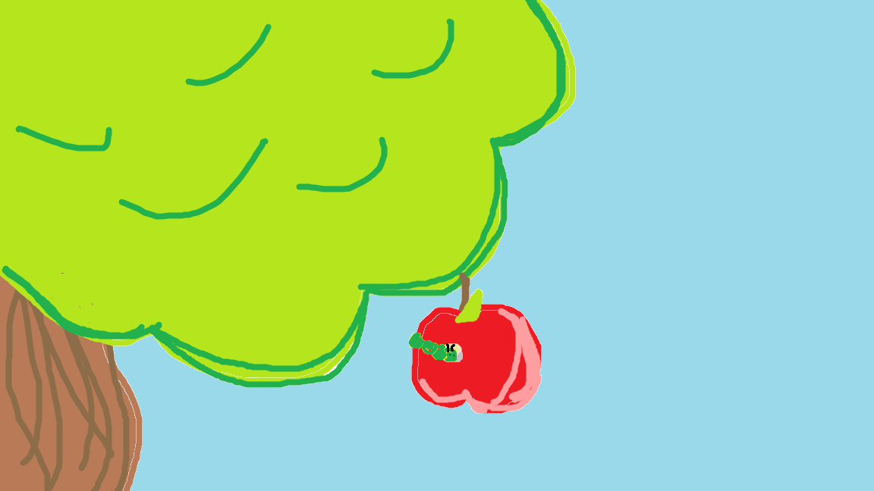
On Monday, he ate through 1 apple but he was still hungry.

Slide 6
On Tuesday, he ate through 2 pears but he was still hungry.

Slide 7
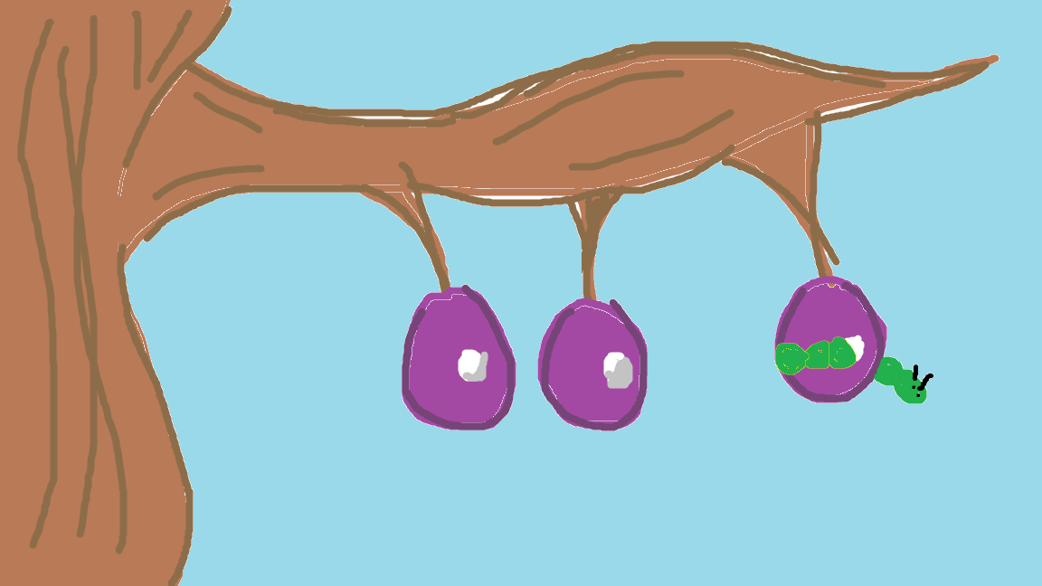
On Wednesday, he ate through 3 plums but he was still hungry.

Slide 8
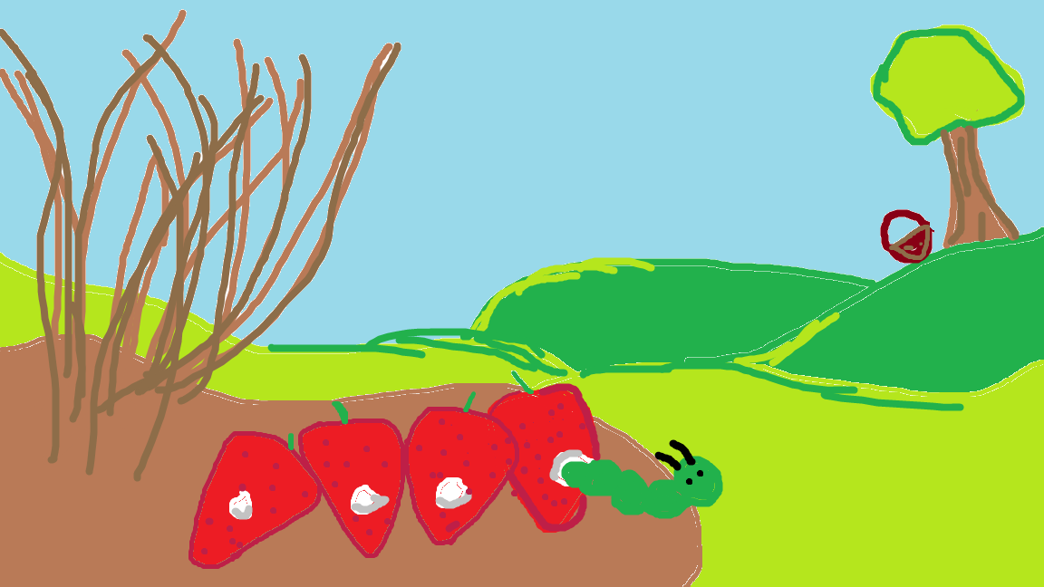
On Thursday, he ate through 4 strawberries but he was still hungry.

Slide 9
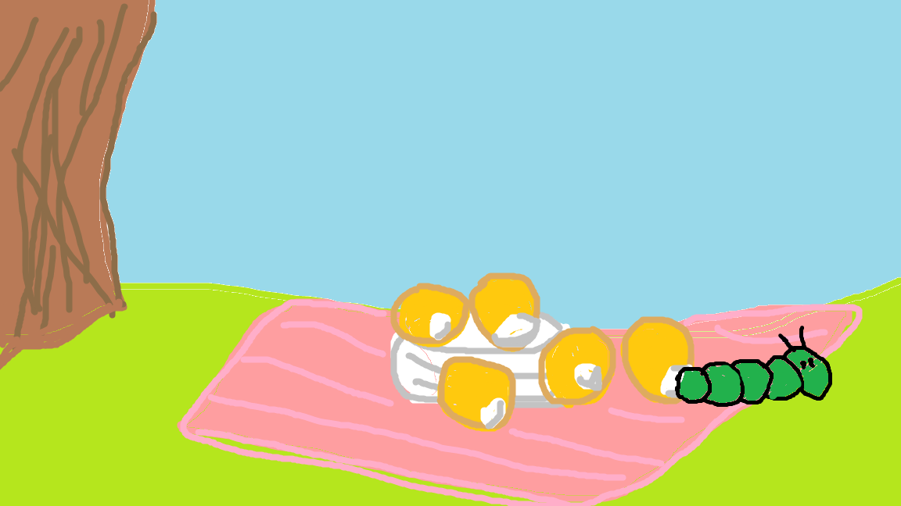
On Friday, he ate through 5 oranges but he was still hungry.

Slide 10
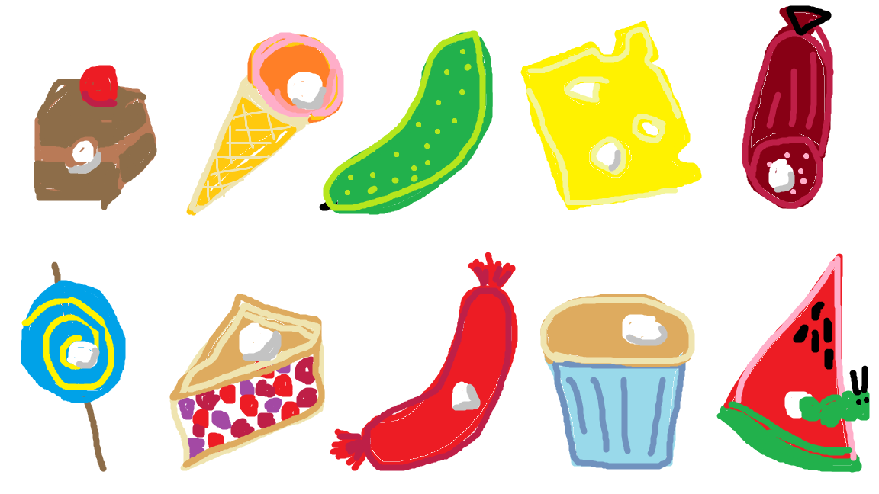
On Saturday, he ate through…
1 piece of chocolate cake, 1 ice cream cone, 1 pickle, 1 slice of Swiss cheese, 1 slice of pepperoni
1 lollipop, 1 slice of cherry pie, 1 sausage, 1 cupcake and 1 slice of watermelon.

Slide 11
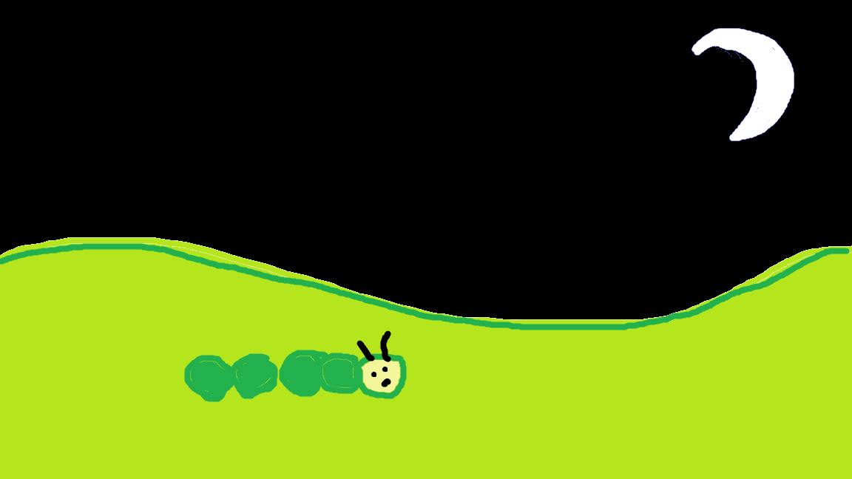
That night he had a stomach-ache.

Slide 12
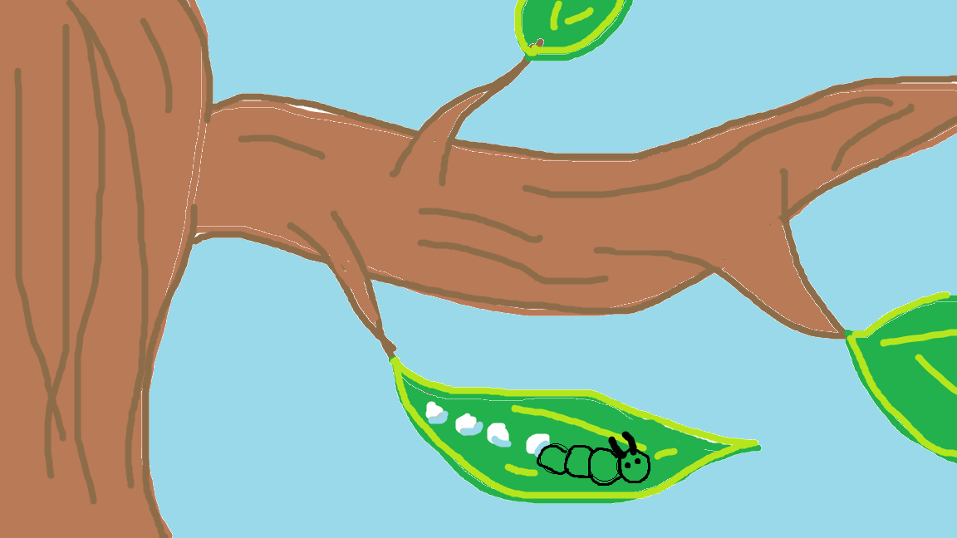
The next day was Sunday again. He ate through one leaf and felt much better.

Slide 13
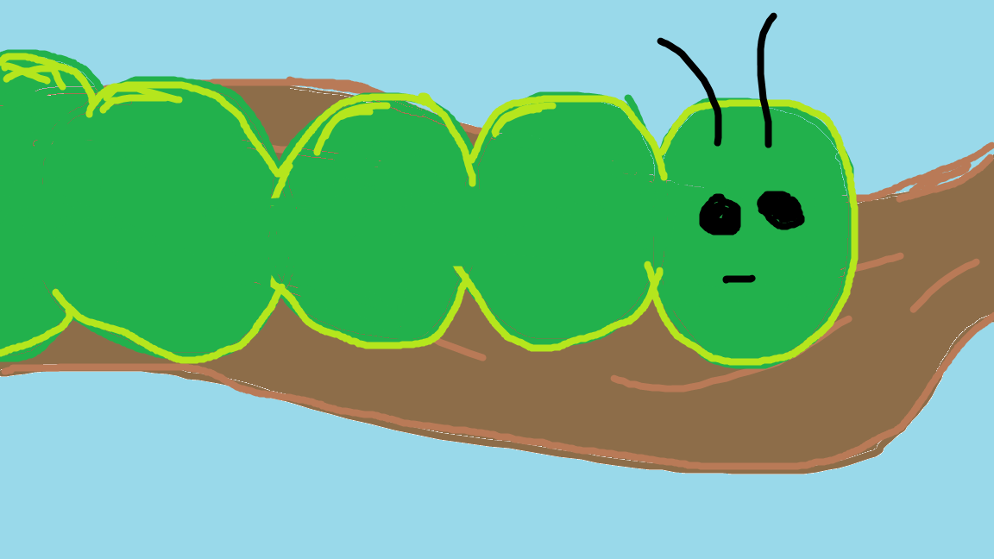
But he wasn’t a tiny caterpillar and smore and he wasn’t hungry. He was a big fat caterpillar.

Slide 14
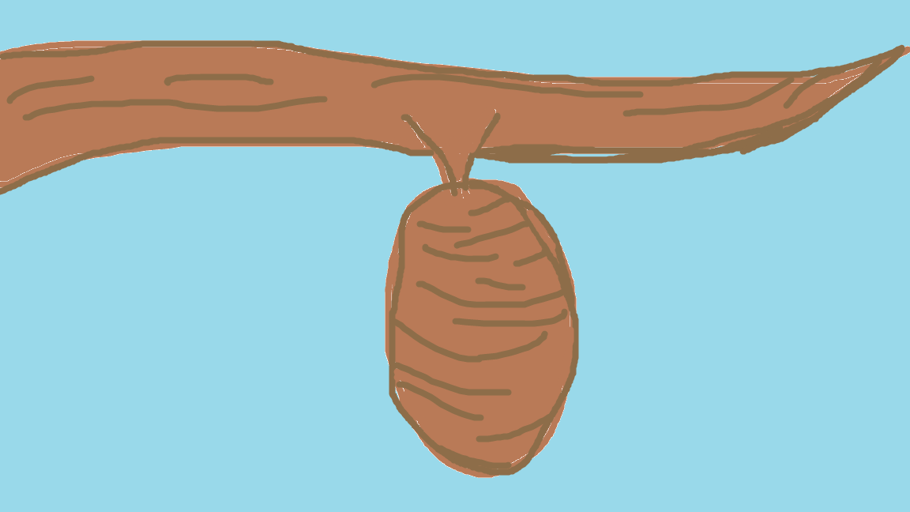
He wrapped himself a cocoon and stayed inside for more than 2 weeks.
Then he nibbled a hole in the cocoon and pushed his way out.

Slide 15
And he was a beautiful butterfly.

